Slide 1
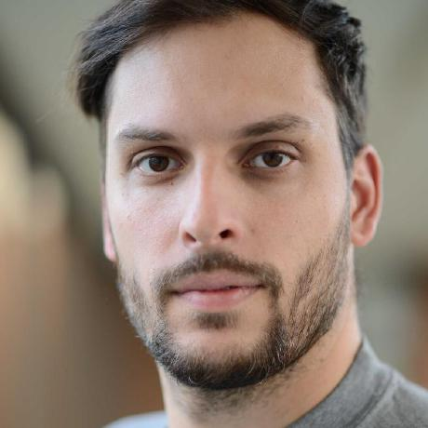



ABOUT ME
Name:
Lukas Lamm
Profession:
M.Sc. Comp. Engineering
Ph.D. Candidate
Institution:
RWTH Aachen University
Institute for Applied Mechanics
@Mechaniac2
llamm-de
LukasLamm

Slide 2

Situation @ RWTH Aachen University
IT Center
High Performance Computing
MATSE
Research Data Management Team
RDM Support
Educational courses (git etc.)

Slide 3



deRSE – Chapter Aachen
Goals
Lobbying for RSE
Networking platform
Centralized information
Additional educational content
Current projects
Finding co-conspiritors
Central event schedule (API)
Chapter website
@AachenRse
RSE-Aachen

